Slide 1

BI BATTLE

Slide 2
Domain: Entertainment and streaming
Problem statement: Analyse user watch history to recommend personalized movie and TV show suggestions.
Data sources: Kaggle
Dataset: Movies and TV Shows, the dataset contains 10,865 records with 30 columns
Key deliverables:
Personalized recommendation system development.
Hybrid model implementation.
OTT dataset analysis for user preferences.
Enhanced engagement through better suggestions.
Metadata analysis for accuracy.
Power BI & Python insights.

Slide 3
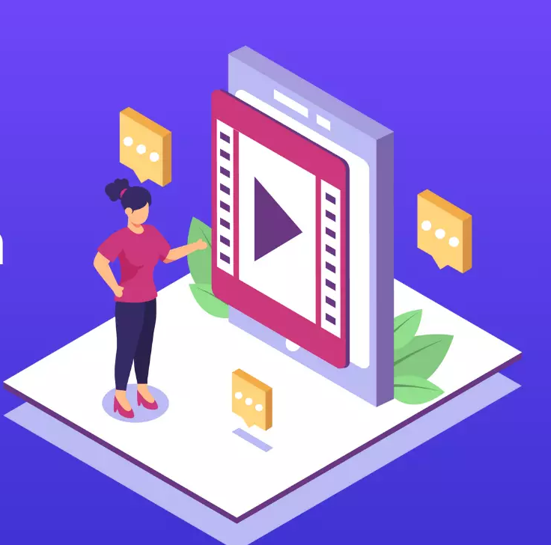
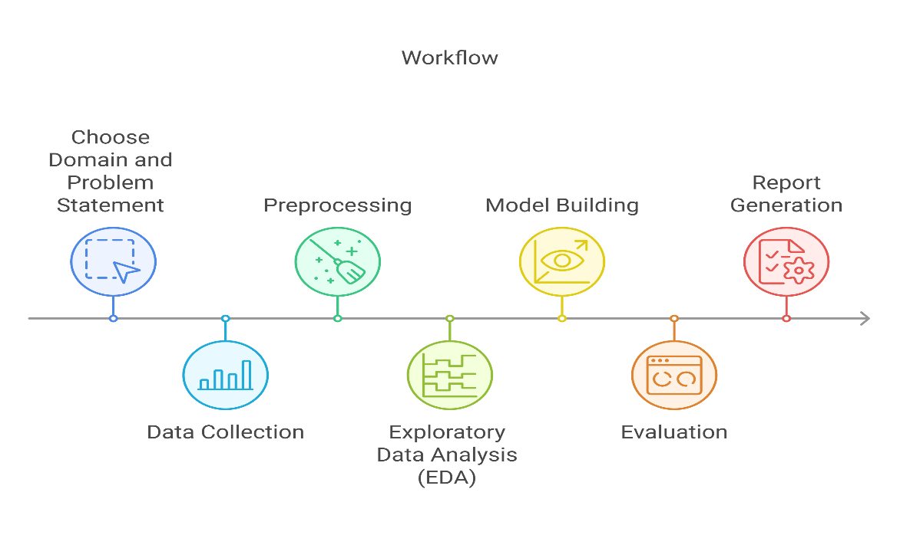
Tools | Purpose
Excel | Data cleaning
Power BI | Data Analysis
Jupyter notebook - Python libraries | Data cleaning, Data Analysis, Machine learning
Microsoft Word | Documenting
Workflow
Techniques:
Data Cleaning
Data Preprocessing
EDA (Exploratory Data Analysis)
Feature Engineering
Machine Learning Model Building
Dashboard Generation

Slide 4
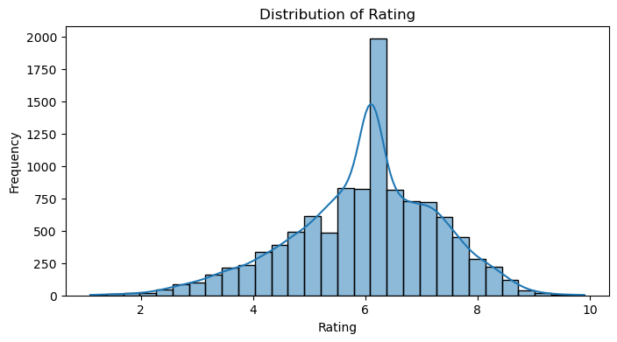
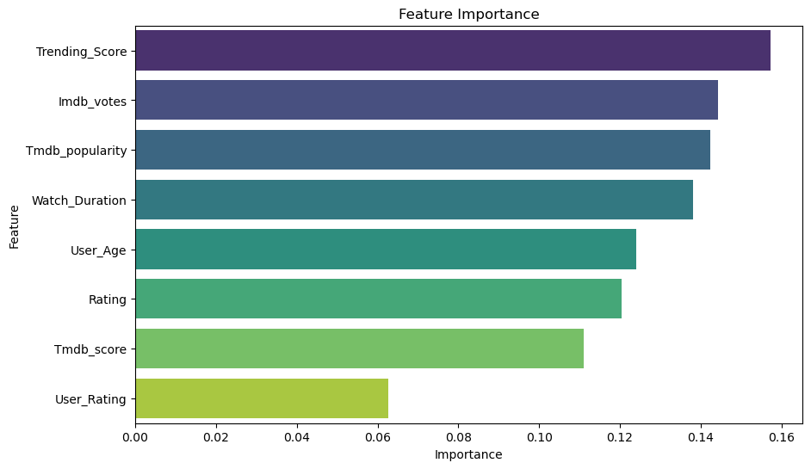
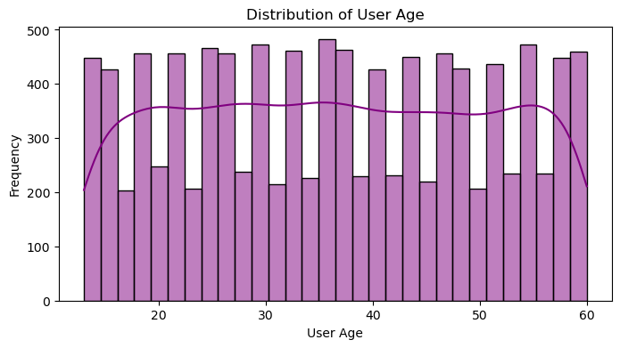
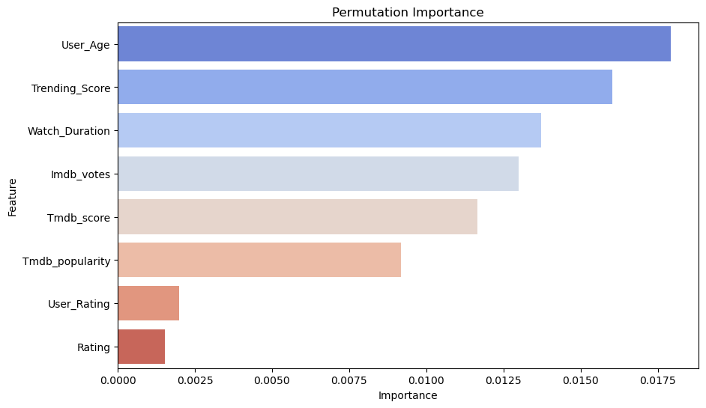

Slide 5
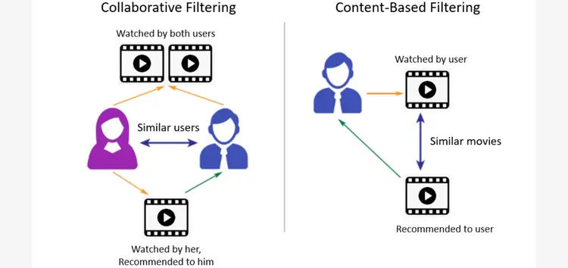
Performance of ML models:
Classification models: Best Performing Model: Random Forest
Hybrid Recommendation System(combination of collaborative filtering & content based filtering):
Top 10 Recommendations for User U1433:
1. Across the Line
2. Red Ribbon Blues
3. No Secrets
4. Wish You Were Here
5. Poola Rangadu
6. Kill Dil
7. Darling
8. Inherit the Viper
9. The 355
10. The Voyeurs
Model | Accuracy | Precision | Recall | F1-Score
Random Forest Classifier | 36.22% | 0.36 | 0.36 | 0.36
Support Vector Machine (SVM) | 33.00% | 0.33 | 0.33 | 0.32
K-Nearest Neighbors (KNN) | 32.21% | 0.32 | 0.32 | 0.32
Logistic Regression | 32.72% | 0.33 | 0.33 | 0.31
XGBoost | 33.96% | 0.34 | 0.34 | 0.34

Slide 6
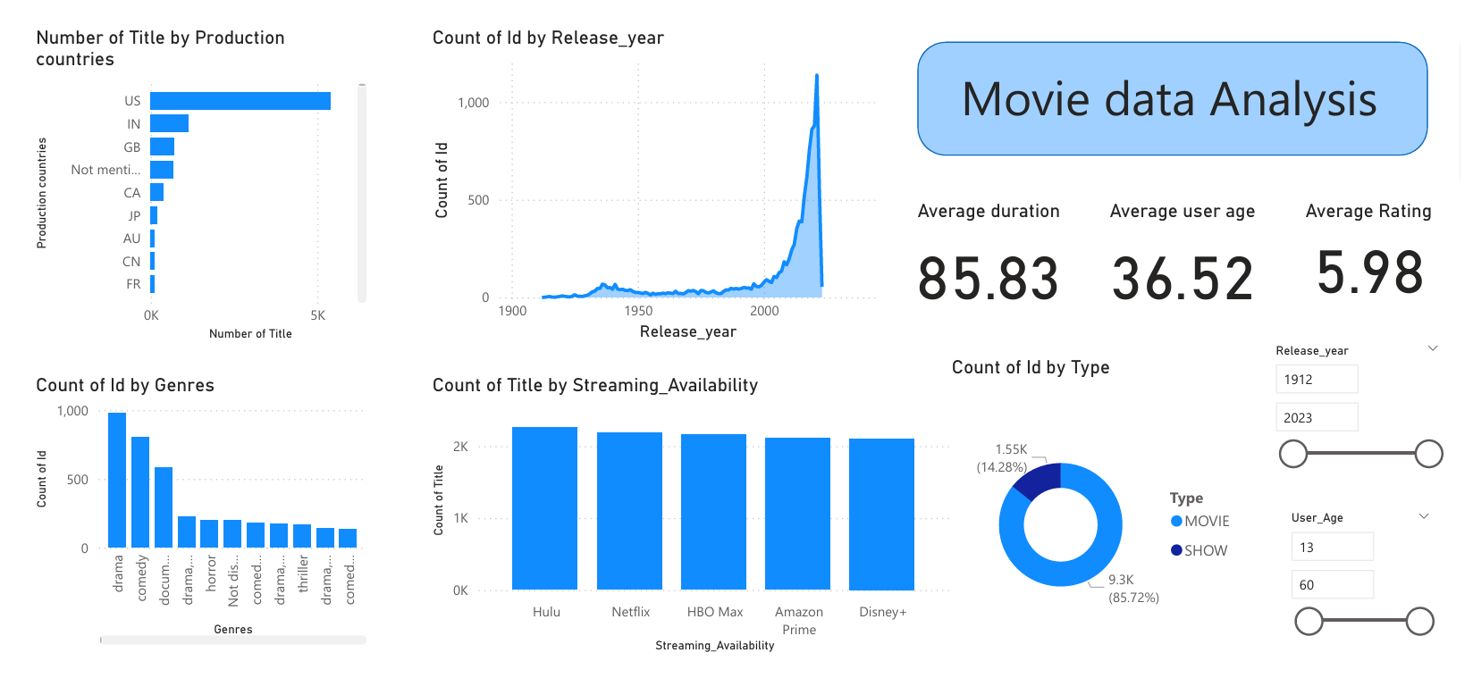
Power BI Analysis

Slide 7
Insights:
User Preferences Drive Engagement – Personalized recommendations increase watch time and reduce content skips.
Hybrid Model Works Best – Combining collaborative & content-based filtering improves accuracy.
Cold Start Challenge – New users benefit from metadata-based recommendations based on age.
Key Influencing Factors – Watch Duration, Trending Score, and User Age impact recommendations the most.
Visual Insights Help – Power BI & Python visualizations reveal trends in genres, ratings, and engagement.

Slide 8
Thank You
Team-10
23MG202A19 – K. Ajitha Reddy

